Slide 1
Introduction (Statistical Description and Data Visualization)

Slide 2


Slide 3
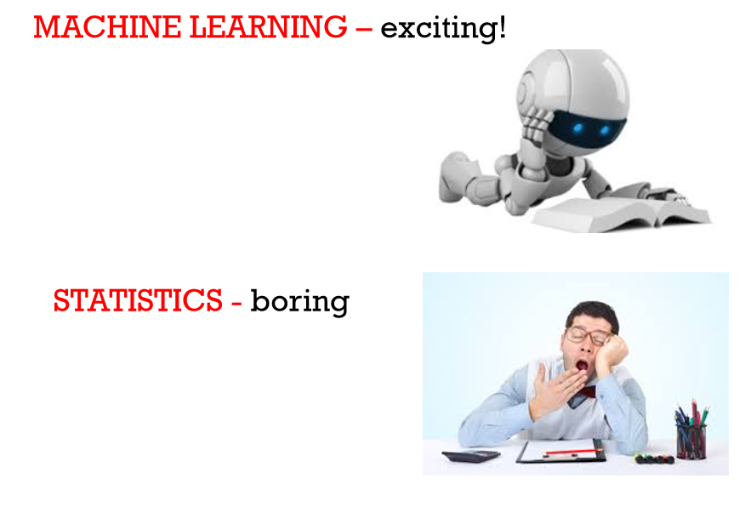

Slide 4
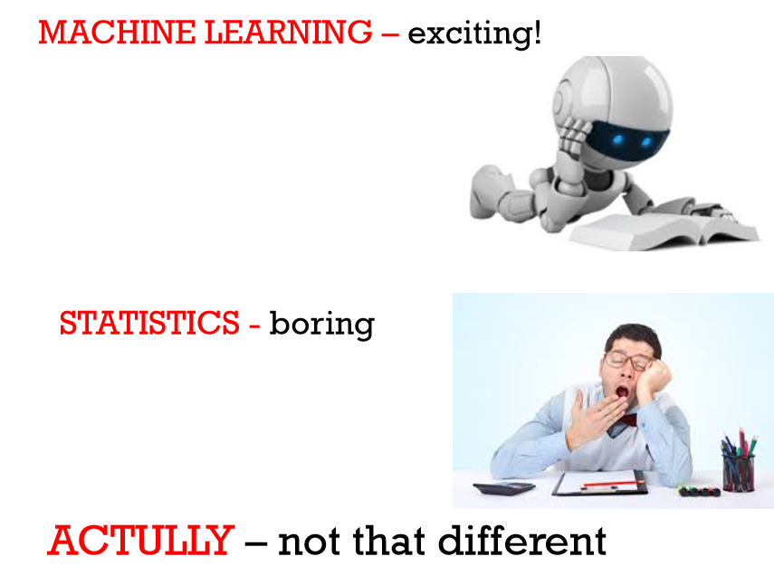

Slide 5
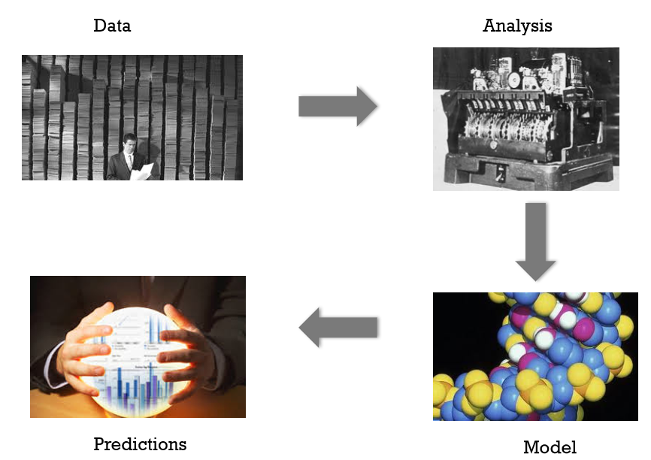
EXTRACTING INFORMATION FROM DATA

Slide 6
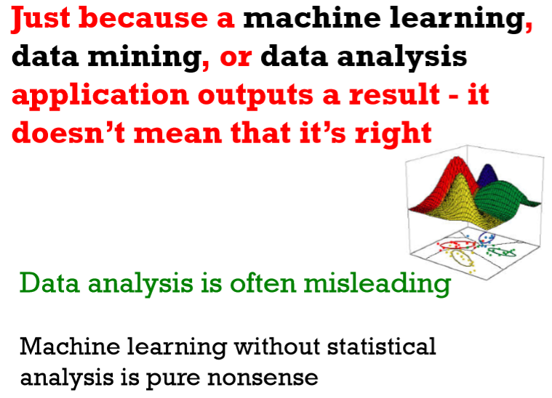

Slide 7
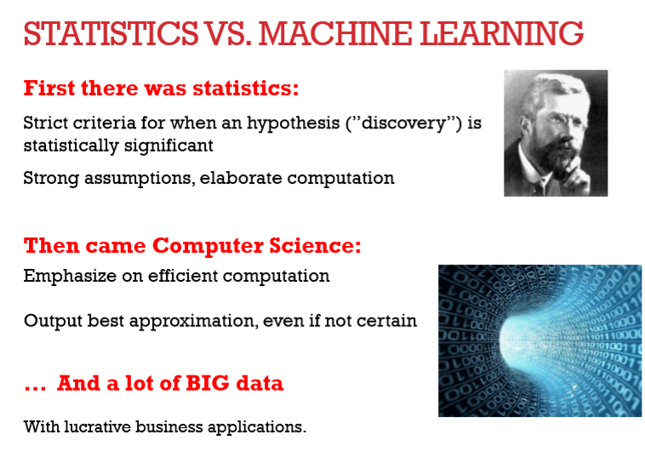

Slide 8
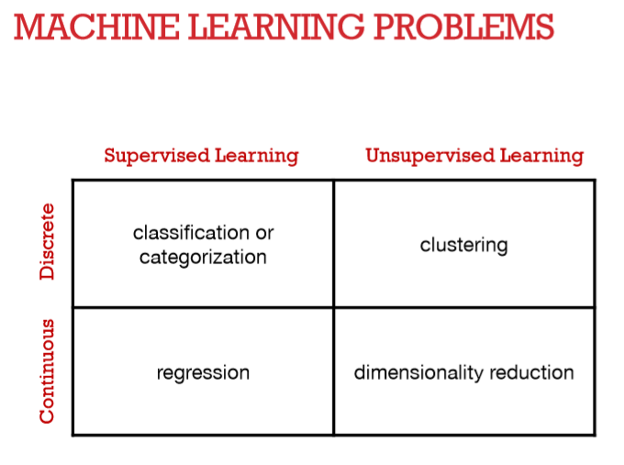

Slide 9
Statistical Description of Data
Descriptive Statistical Analysis helps you to understand your data and is a very important part of Machine Learning.
This is due to Machine Learning being all about making predictions.
On the other hand, statistics is all about drawing conclusions from data, which is a necessary initial step.

Slide 10
Statistical Description of Data
Statistics is a branch of mathematics that deals with collecting, interpreting, organization and interpretation of data.
Within statistics, there are two main categories:
Descriptive Statistics: In Descriptive Statistics your are describing, presenting, summarizing and organizing your data (population), either through numerical calculations or graphs or tables.
Inferential statistics: Inferential Statistics are produced by more complex mathematical calculations, and allow us to infer trends and make assumptions and predictions about a population based on a study of a sample taken from it.

Slide 11
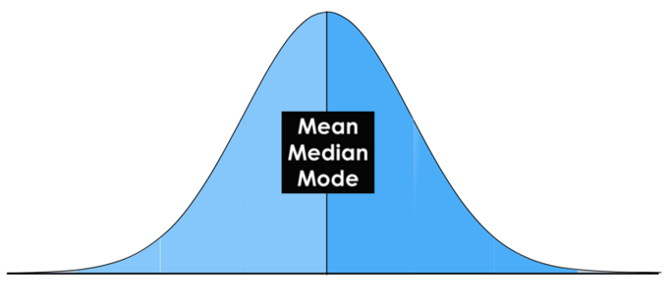
Normal Distribution
A normal Distribution is given if your data is symmetrical, bell-shaped, centered and unimodal.

Slide 12
Central Tendency (mean, mode, median)
In statistics we have to deal with the mean, mode and the median. These are also called the “Central Tendency”.
The mean is simply the average.
The mode is the value or category that occurs most often within the data.
The median is the “middle” value or midpoint in your data

Slide 13
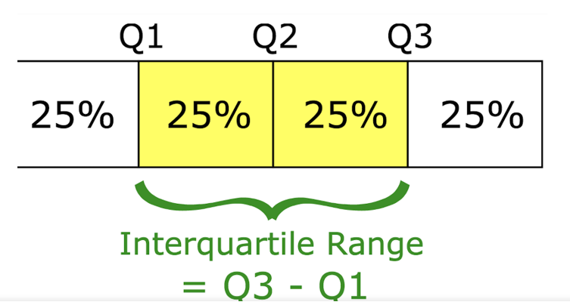
Measures of Variability
The most popular variability measures are the range, interquartile range (IQR), variance, and standard deviation.
The range describes the difference between the largest and the smallest points in your data.
The interquartile range (IQR) is a measure of statistical dispersion between upper (75th) and lower (25th) quartiles.
While the range measures where the beginning and end of your data point are, the interquartile range is a measure of where the majority of the values lie.

Slide 14
Variance and Standard Deviation
The Standard Deviation and the Variance also measure, like the Range and IQR, how spread apart our data is (e.g the dispersion). Therefore they are both derived from the mean.
The variance is computed by finding the difference between every data point and the mean, squaring them, summing them up and then taking the average of those numbers.
Standard Deviation is used more often because it is in the original unit. It is simply the square root of the variance and because of that, it is returned to the original unit of measurement.

Slide 15

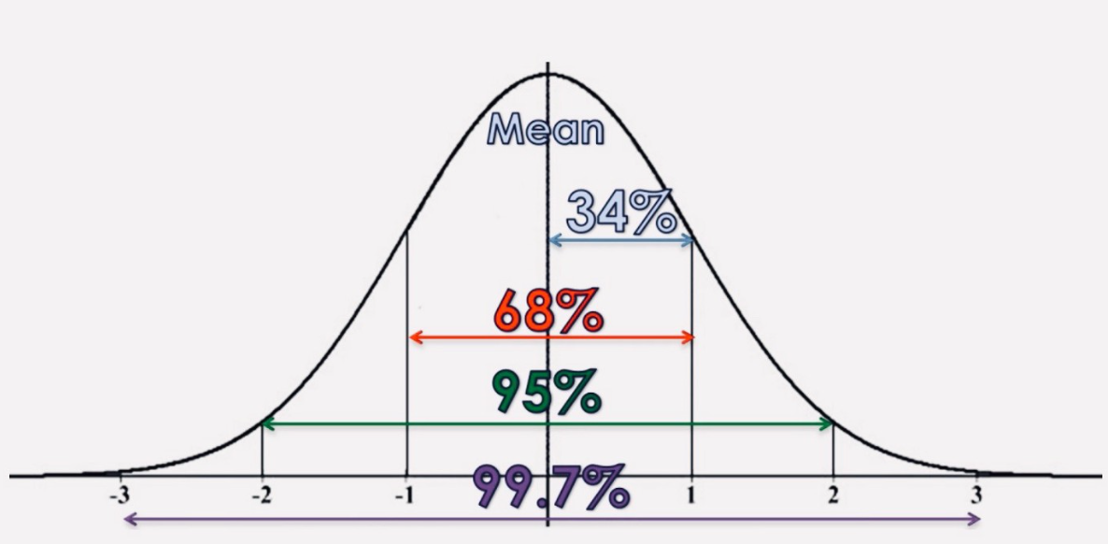
Variance and Standard Deviation

Slide 16
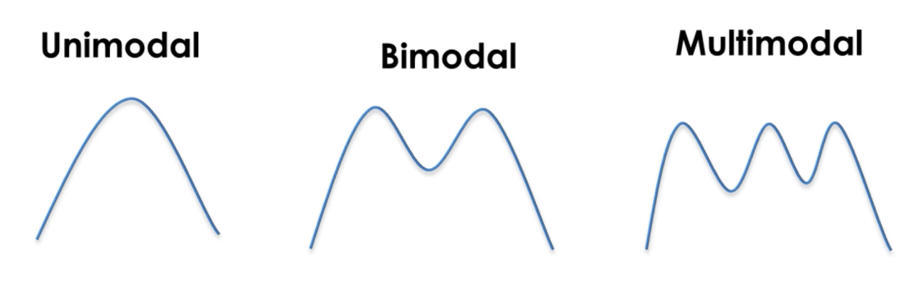
Modality
The modality of a distribution is determined by the number of peaks it contains. Most distributions have only one peak but it is possible that you encounter distributions with two or more peaks.

Slide 17
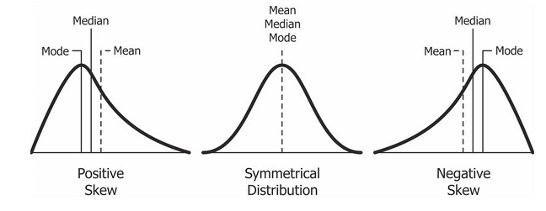
Skewness
Skewness is a measurement of the symmetry of a distribution.
Therefore it describes how much a distribution differs from a normal distribution, either to the left or to the right. The skewness value can be either positive, negative or zero.
Note that a perfect normal distribution would have a skewness of zero because the mean equals the median.

Slide 18
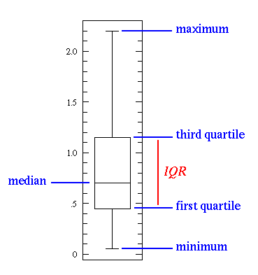
Statistical Features
A Box Plot

Slide 19
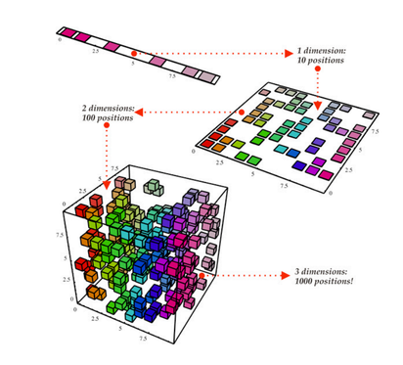
Dimensionality Reduction
The term Dimensionality Reduction is quite intuitive to understand. We have a dataset and we would like to reduce the number of dimensions it has. In data science this is the number of feature variables.
Another way we can do dimensionality reduction is through feature pruning. With feature pruning we basically want to remove any features we see will be unimportant to our analysis
The most common stats technique used for dimensionality reduction is PCA which essentially creates vector representations of features showing how important they are to the output i.e their correlation.

Slide 20
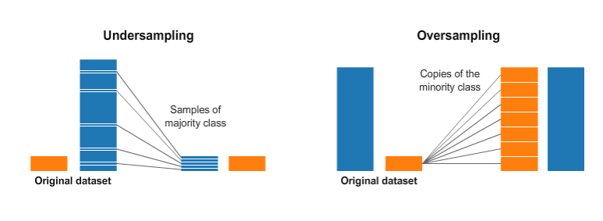
Over and Under Sampling
Over and Under Sampling are techniques used for classification problems.
Sometimes, our classification dataset might be too heavily tipped to one side.
For example, we have 2000 examples for class 1, but only 200 for class 2.

Slide 21
Data Visualization
Data visualization is a very important part of data analysis. You can use it to explore your data.
If you understand your data well, you’ll have a better chance to find some insights.
Finally, when you find any insights, you can use visualizations again to be able to share your findings with other people.

Slide 22
Basic Visualization Rules
Before we look at some kinds of plots, we’ll introduce some basic rules. Those rules help us make nice and informative plots instead of confusing ones.
The first step is to choose the appropriate plot type. If there are various options, we can try to compare them, and choose the one that fits our model the best.
Second, when we choose your type of plot, one of the most important things is to label your axis. If we don’t do this, the plot is not informative enough.
Third, we can add a title to make our plot more informative.
Fourth, add labels for different categories when needed.
Five, optionally we can add a text or an arrow at interesting data points.
Six, in some cases we can use some sizes and colors of the data to make the plot more informative.

Slide 23
Types of Visualizations
There are many types of visualizations. Some of the most famous are:
line plot,
scatter plot,
histogram,
box plot,
bar chart, and
pie chart

Slide 24
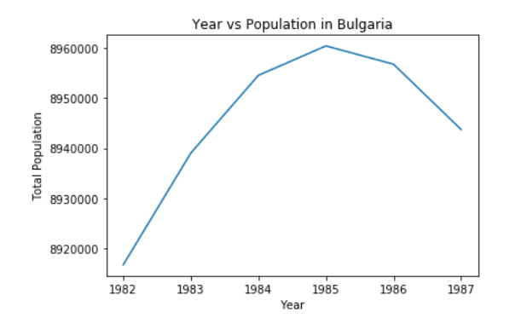
Line Plot
a type of plot which displays information as a series of data points called “markers” connected by straight lines.
In this type of plot, we need the measurement points to be ordered (typically by their x-axis values).
This type of plot is often used to visualize a trend in data over intervals of time - a time series.

Slide 25
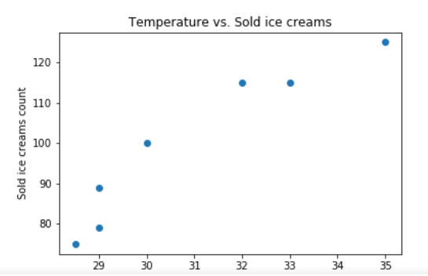
Scatter plot
This type of plot shows all individual data points.
Here, they aren’t connected with lines. Each data point has the value of the x-axis value and the value from the y-axis values.
This type of plot can be used to display trends or correlations.

Slide 26
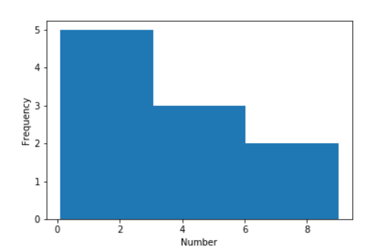
Histogram
An accurate representation of the distribution of numeric data.
To create a histogram, first, we divide the entire range of values into a series of intervals, and second, we count how many values fall into each interval. The intervals are also called bins.
The bins are consecutive and non-overlapping intervals of a variable. They must be adjacent and are often of equal size.

Slide 27
Box plot
It is also called the box-and-whisker plot: a way to show the distribution of values based on the five-number summary: minimum, first quartile, median, third quartile, and maximum.
The minimum and the maximum are just the min and max values from our data.
The median is the value that separates the higher half of a data from the lower half. It’s calculated by the following steps: order your values, and find the middle one. In a case when our count of values is even, we actually have 2 middle numbers, so the median here is calculated by summing these 2 numbers and divide the sum by 2. For example, if we have the numbers 1, 2, 5, 6, 8, 9, your median will be (5 + 6) / 2 = 5.5.
The first quartile is the median of the data values to the left of the median in our ordered values. For example, if we have the numbers 1, 3, 4, 7, 8, 8, 9, the first quartile is the median from the 1, 3, 4 values, so it’s 3.
The third quartile is the median of the data values to the right of the median in our ordered values. For example, if we use these numbers 1, 3, 4, 7, 8, 8, 9 again, the third quartile is the median from the 8, 8, 9 values, so it’s 8.

Slide 28
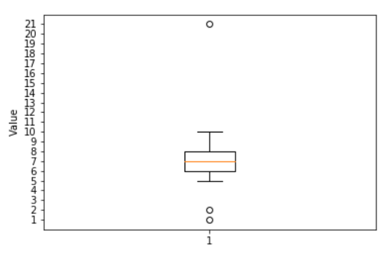
Box plot
IQR (Interquartile Range). The IQR approximates the amount of spread in the middle 50% of the data. The formula is the third quartile - the first quartile.
This type of plot can also show outliers. An outlier is a data value that lies outside the overall pattern. They are visualized as circles. When we have outliers, the minimum and the maximum are visualized as the min and the max values from the values which aren’t outliers. There are many ways to identify what is an outlier. A commonly used rule says that a value is an outlier if it’s less than the first quartile - 1.5 * IQR or high than the third quartile + 1.5 * IQR.

Slide 29
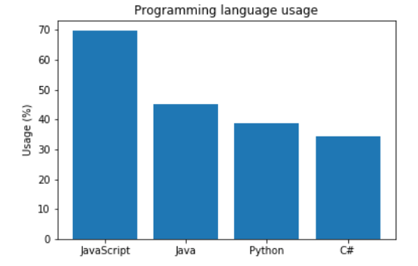
Bar chart
Represents categorical data with rectangular bars. Each bar has a height corresponds to the value it represents.
It’s useful when we want to compare a given numeric value on different categories.

Slide 30
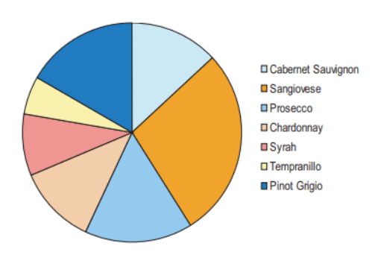
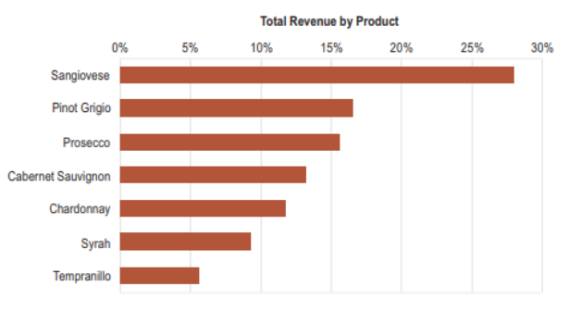
Pie chart
A circular plot, divided into slices to show numerical proportion.
They are widely used in the business world.
However, many experts recommend to avoid them.
The main reason is that it’s difficult to compare the sections of a given pie chart.
Also, it’s difficult to compare data across multiple pie charts. In many cases, they can be replaced by a bar chart.

Slide 31
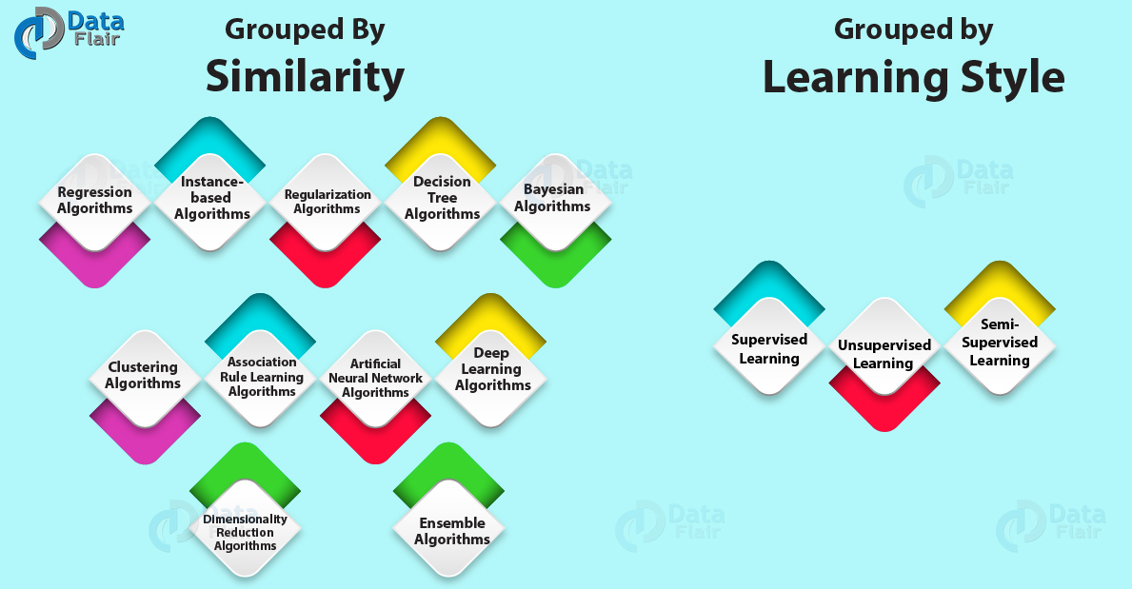
Introduction to Machine Learning Algorithms

